Slide 1
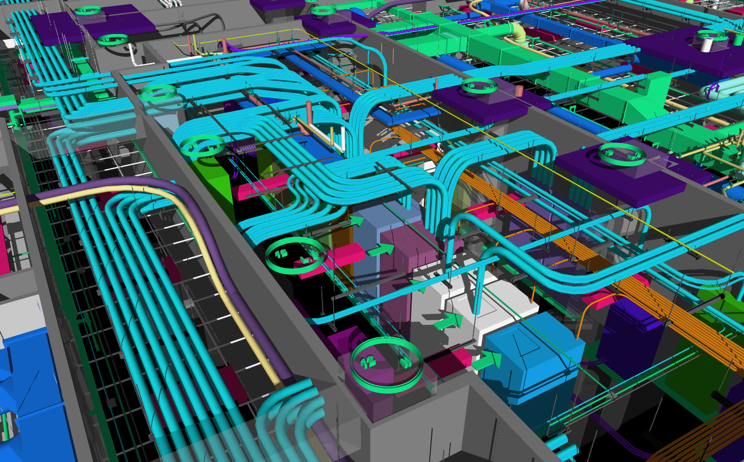
THIRD QUARTER 2024 FINANCIAL RESULTS
October 31, 2024

Slide 2
FORWARD-LOOKING STATEMENTS AND NON-GAAP FINANCIAL DISCLOSURES
Forward-Looking Statements
This presentation and related press release contain forward-looking statements. Such statements speak only as of the date on the cover of this slide deck, and EMCOR assumes no obligation to update any such forward-looking statements, unless required by law. These forward-looking statement include statements regarding anticipated future operating and financial performance, including financial guidance and projections underlying that guidance; the nature and impact of our remaining performance obligations and timing of future projects; our ability to support organic growth and balanced capital allocation; market opportunities; market growth prospects; customer trends; and project mix. These forward-looking statements involve risks and uncertainties that could cause actual results to differ materially from those anticipated (whether expressly or implied) by the forward-looking statements. Accordingly, these statements do not guarantee future performance or events. Applicable risks and uncertainties include, but are not limited to, adverse effects of general economic conditions; domestic and international political developments; changes in the specific markets for EMCOR’s services; adverse business conditions, including labor market tightness and/or disruption, productivity challenges, the impact of claims and litigation, the nature and extent of supply chain disruptions impacting availability and pricing of materials, global conflicts, and inflationary trends more generally, including fluctuations in energy costs; the impact of legislation and/or government regulations; changes in interest rates; the availability of adequate levels of surety bonding; increased competition; and unfavorable developments in the mix of our business. Certain of the risk factors associated with EMCOR’s business are also discussed in Part I, Item 1A “Risk Factors,” of the Company’s 2023 Form 10-K, and in other reports filed from time to time with the Securities and Exchange Commission and available at www.sec.gov and www.emcorgroup.com. Such risk factors should be taken into account in evaluating our business, including any forward-looking statements.
Non-GAAP Measures
This presentation and related press release also include certain financial measures that were not prepared in accordance with U.S. generally accepted accounting principles (GAAP). Reconciliations of those non-GAAP financial measures to the most directly comparable GAAP financial measures are included in the press release that accompanies this presentation. The Company uses these non-GAAP measures as key performance indicators for the purpose of evaluating performance internally. We also believe that these non-GAAP measures provide investors with useful information with respect to our ongoing operations. Any non-GAAP financial measures presented are not, and should not be viewed as, substitutes for financial measures required by GAAP, have no standardized meaning prescribed by GAAP, and may not be comparable to the calculation of similar measures of other companies.

Slide 3
EMCOR PARTICIPANTS
Tony Guzzi Chairman, President & Chief Executive Officer
Jason Nalbandian SVP & Chief Financial Officer
Maxine Mauricio EVP, Chief Administrative Officer & General Counsel
Andy Backman VP, Investor Relations

Slide 4
executive summary
($ Millions, except per share information) | 3Q24 | 3Q23 | Change ($) | Change (%)
Revenues | $3,697 | $3,208 | $489 | 15.3%
Operating Income¹ | $364 | $235 | $129 | 54.7%
Operating Margin¹ | 9.8% | 7.3%
Diluted EPS² | $5.80 | $3.57 | $2.23 | 62.5%
(Unaudited)
Continued to perform exceptionally well, maintained momentum, delivered excellent quarter
Record Quarterly Revenues, Operating Income, Operating Margin, Diluted EPS, Operating Cash Flow
Record Remaining Performance Obligations (RPOs) of $9.8 billion, up $1.15 billion or 13.4% year-over-year driven by strong demand across the majority of the sectors we serve
Excellent field leadership, focused project planning and estimating, and a commitment to continuous innovation, including investments in VDC / BIM and prefabrication, creating efficiencies that increase productivity and further improve execution
Executing well in large and growing sectors with strong demand and long-term secular trends, including network and communications (e.g., data centers), high-tech manufacturing (e.g., semiconductor plants) and traditional manufacturing, institutional, and healthcare
Balance sheet remains strong and liquid, supporting organic growth and balanced capital allocation model, while enabling us to compete and win on sophisticated projects
2024 Revenue guidance of at least $14.5 billion (previously $14.5 billion - $15.0 billion)
2024 Diluted EPS guidance increased to $20.50 - $21.00 (previously $19.00 - $20.00)
¹ Includes $2.4 million impairment loss on long-lived assets in 2023
² Includes $2.4 million ($1.7 million after tax) impairment loss on long-lived assets in 2023

Slide 5
third Quarter – REVENUES
Consolidated quarterly revenues of $3.70 billion

Slide 6
third Quarter – OPERATING INCOME
$363.5 million or 9.8% of revenues; +$129 million Y/Y
Operating Margin % by Segment
Q3 2023 Q3 2024
U.S. Electrical
Construction
& Facilities
Services
U.S. Mechanical
Construction
& Facilities
Services
Total
U.S.
Construction
U.S.
Building
Services
U.S.
Industrial
Services
U.K.
Building
Services
Total
EMCOR ¹
¹ Includes $2.4 million impairment loss on long-lived assets in 2023

Slide 7
KEY FINANCIAL DATA – INCOME STATEMENT
($ Thousands, except per share information)
(Unaudited)
¹ Includes $2.4 million impairment loss on long-lived assets in 2023
² Includes $2.4 million ($1.7 million after tax) impairment loss on long-lived assets in 2023

Slide 8
KEY FINANCIAL DATA – INCOME STATEMENT
($ Thousands, except per share information)
(Unaudited)
¹ Includes $2.4 million impairment loss on long-lived assets in 2023
² Includes $2.4 million ($1.7 million after tax) impairment loss on long-lived assets in 2023

Slide 9
KEY FINANCIAL DATA – balance sheet
($ Thousands)

Slide 10
WELL-POSITIONED TO BENEFIT FROM MULTIPLE TRENDS DRIVING PROFITABLE ORGANIC GROWTH
Data Centers and Connectivity
Re-Shoring and Nearshoring
Electrification
and EV Value Chain
Energy Efficiency and
Sustainability
Legislative Tailwinds
Continued Demand Drivers
Increased Power Requirements
AI Accelerated Buildout / Retrofit / Remodel
Critical supply chain resilience
Capacity shifting / expansion
Automation
Energy transition and expansion
Renewable buildout and grid modernization
Large scale solar, carbon capture and biofuels
Sustainable, efficient, cost-saving building initiatives
Equipment replacement and modernization
Government incentives enhancing and extending growth
CHIPS and Science Act
Inflation Reduction Act
Beneficiaries
Hyperscalers
Colocation Providers
Enterprise
Technology and Financial Companies
Government
Semiconductor Manufacturing
Pharmaceuticals
Life Sciences
Medical Devices
Computer and Electronics
EV and EV Battery Manufacturing
Electrical Charging Stations
Large-Scale Solar Projects
Refineries
Healthcare, Manufacturing, Institutional, and other Commercial
Multisector Retrofit Projects
Semiconductor Manufacturing
R&D Facilities
Institutional
Alignment
Construction Services
Construction Services
Construction Services
Construction Services
Construction Services
Building Services
Building Services
Industrial Services
Building Services
Building Services
Relevant RPO Categories
(Sequential /
y/y growth)
Network & Communications
+25% / +55%
High-Tech Manufacturing:
-2% / -7%
Mech. Services:
-2% / +4%
Across multiple categories
Manufacturing and Industrial:
+18% / +8%
Healthcare:
+3% / +19%

Slide 11
REMAINING PERFORMANCE OBLIGATIONS
Diverse RPOs of $9.8 billion; +$1.15 billion Y/Y
By Segment ($ Millions) (Unaudited)
By Market Sector ($ Millions) (Unaudited)
$9,789
$9,789
$8,635
$8,847
$8,635
$8,847
Mechanical
Electrical
Building Services
Commercial
Network & Communications
High-Tech Manufacturing
Industrial Services
EMCOR UK
Healthcare
Institutional
Manufacturing & Industrial
Water & Wastewater
Hospitality & Entertainment
Transportation
Short Duration Projects

Slide 12
2024 GUIDANCE - REVISED
 | Revised Guidance | Prior Guidance
Revenues | At least $14.5 Billion | $14.5 Billion - $15.0 Billion
Diluted EPS¹ | $20.50 - $21.00 | $19.00 - $20.00
Record RPOs of $9.8 billion, along with strong and diverse pipeline, provide solid near-term line of sight
Continued strength in secular end markets with long-term growth prospects
Robust demand for fire life safety projects and services across most sectors
Solid aftermarket growth opportunities driven by energy efficiency / IAQ, HVAC retrofit, and building controls installations and upgrades
Strong field leadership, focused project planning and estimating, along with investments in VDC / BIM and prefabrication, continue to create efficiencies that increase productivity and further improve execution
Oil and gas markets continue steady pace of improvement
Remain diligent in serving private equity and commercial real estate customers with potential balance sheet issues
Continued uncertainties include elevated interest rates, the impact of global conflicts, and energy market and supply chain disruption
¹ Assumes 27.0% to 27.5% effective tax rate

Slide 13
CAPITAL ALLOCATION TRENDS
EMCOR Capital Allocation by Year (%)
~55%
~45%
*
*
Business Reinvestment
Shareholder Return
Acquisitions
Capex
Dividends
Share Repurchases
* Through 9/30/24

Slide 14
Thank You

